Slide 1
DEATH AND BEREAVEMENT ACROSS CULTURES
NUR ATIKAH MOHAMED HUSSIN
TAMPERE UNIVERSITY
UNIVERSITI SAINS MALAYSIA

Slide 2
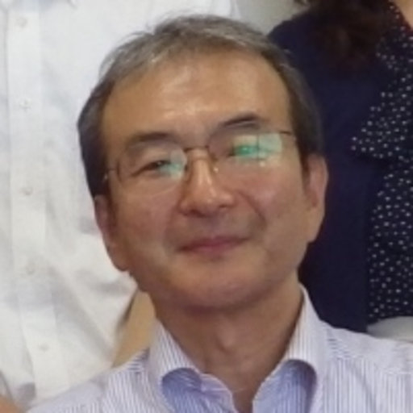
To discuss on this topic, I would like to share a presentation from a Japanese researcher, Prof Tomofumi Oka who is an expert in self help groups in Japan. Watch the presentation here!

